Slide 1

CMIT Project: Pebble Mosaic by SLIC and Segmentation
Designed by Shavarsh Melikyan
Supervisor: Prof. Andreas Alpers

Slide 2
Today’s Agenda:
Main Problem – SLIC Implementation
Skimage and other libraries
Process and variations
Observations and comparisons with other methods
Conclusion
Further steps

Slide 3
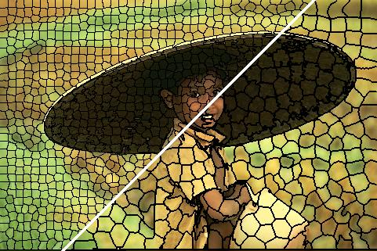
MegaPixels and SLIC: Simple Linear Iterative Clustering

Slide 4
What is SLIC and what are the MegaPixels?
SuperPixels – (AKA MegaPixels) are local groupings of other pixels for easy and faster data processing
SLIC – Algorithm which produces the above mentioned SuperPixels from the inputted image by clustering pixels into groups, based on colour and spatial distance

Slide 5
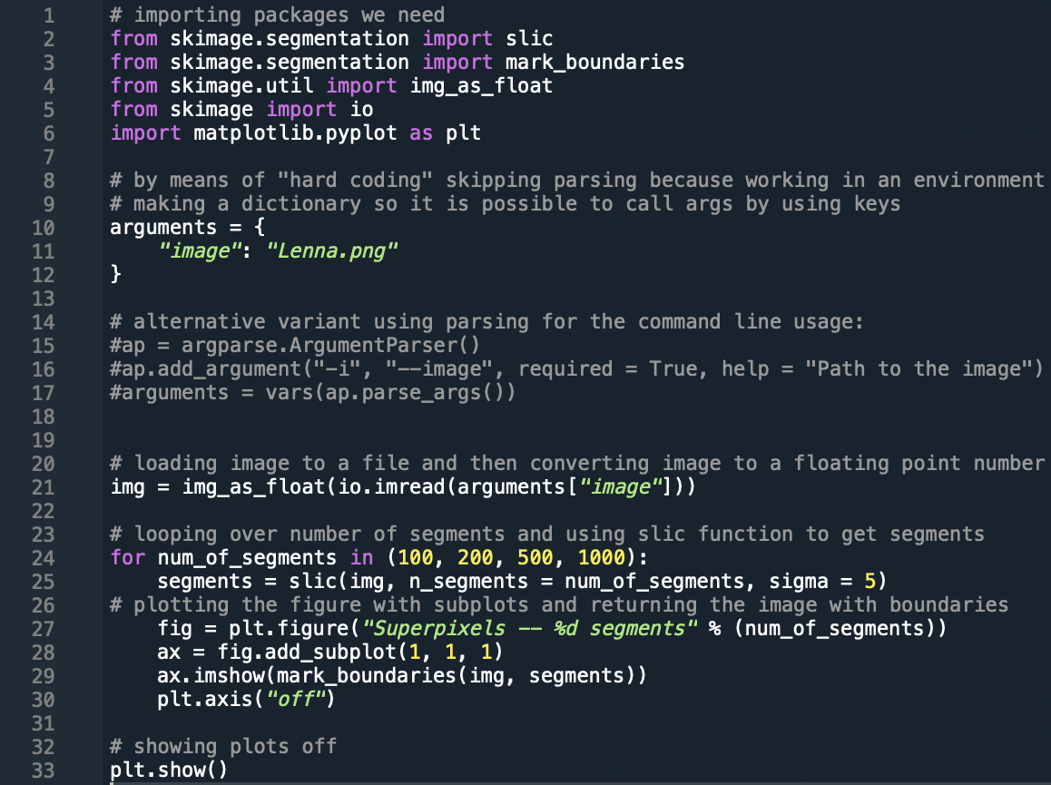
Code:

Slide 6
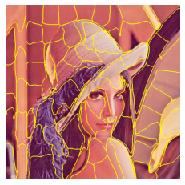

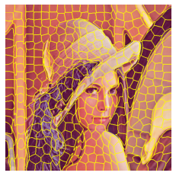
More examples:
Small amount of Pixels
Average Amount
High amount

Slide 7
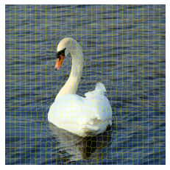
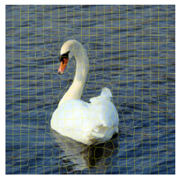
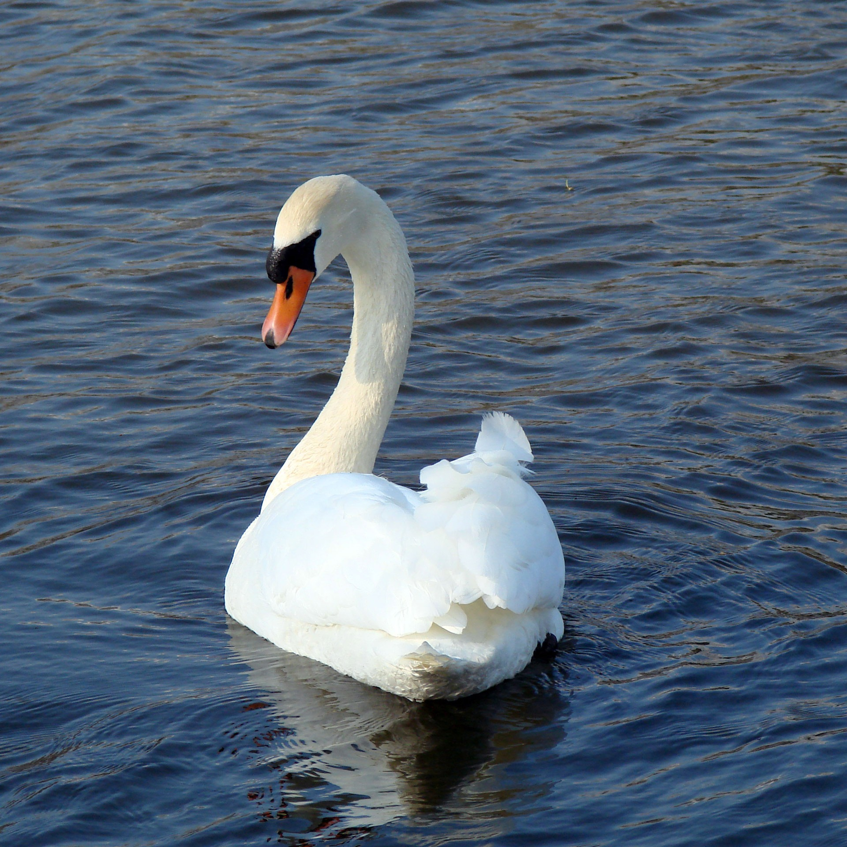
Examples:
High Compactness
High Sigma
Regular Pic

Slide 8
Further Changes and Improvements:
Continue working on an optimisation of the problem in terms of complexity
Continue working on the project itself by adding new features and new functionality

Slide 9
Thank you for your attention
Designed by Shavarsh Melikyan
Supervisor: Prof. Andreas Alpers

